Slide 1






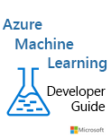




Kyle Bunting
Senior Data & AI Engineer
23+ years in IT
MBA, Krannert School of Management, Purdue University
Author / contributor of multiple books and whitepapers
kyle@solliance.net
https://github.com/kylebunting
https://www.linkedin.com/in/kylebunting

